Slide 1
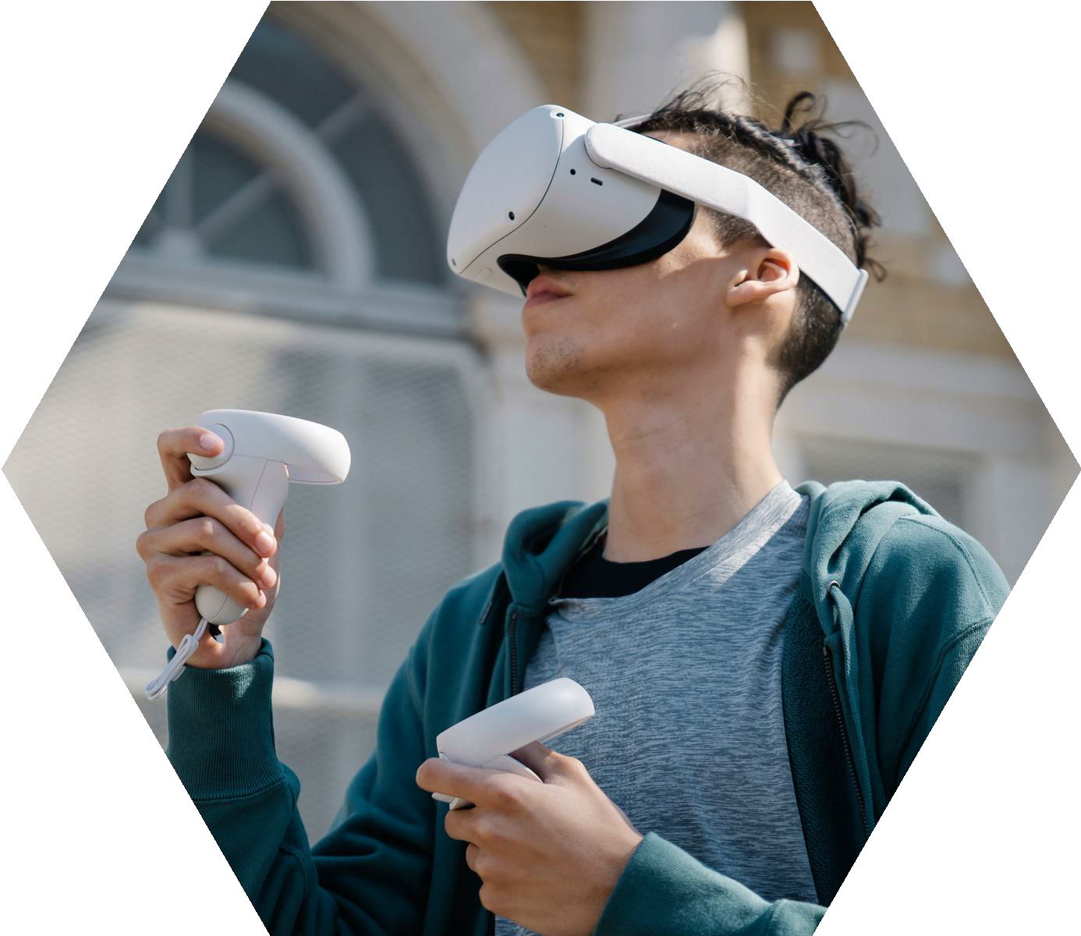
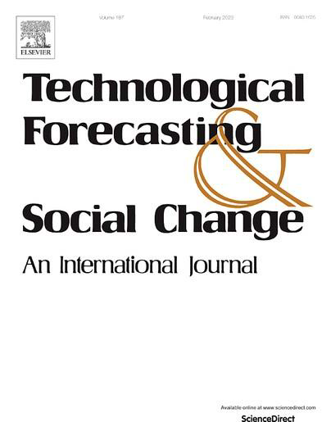
Delineatingtheroleof
moodmaintenancein
augmentingreality(AR)
serviceexperiences:
Anapplicationin
tourism
TSENG-LUNGHUANG,
RODOULAH.TSIOTSOU &
BENS.LIU

Slide 2
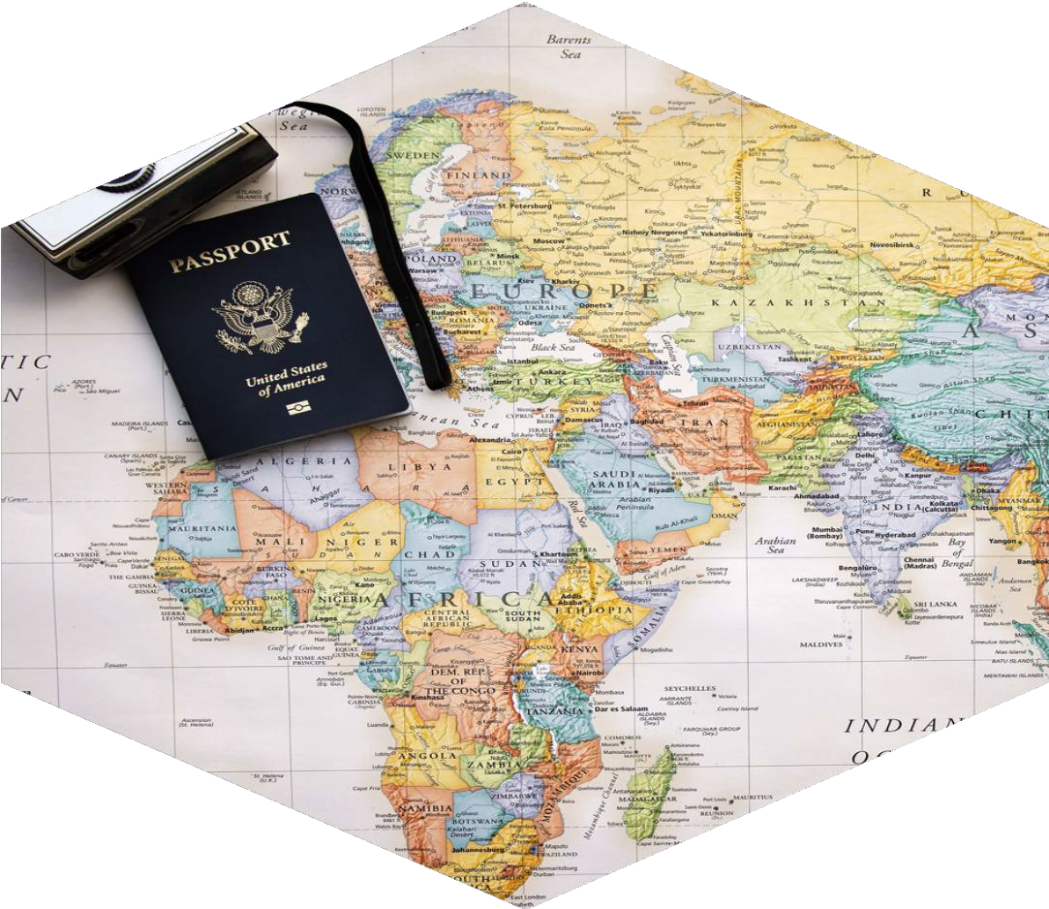
PURPOSE
This study exploredthe antecedents and
consequences of mood maintenance activities
in AR service experiences, considering
possible moderators.
Tseng-LungHuang,RodoulaH.Tsiotsou&BenS.Liu

Slide 3
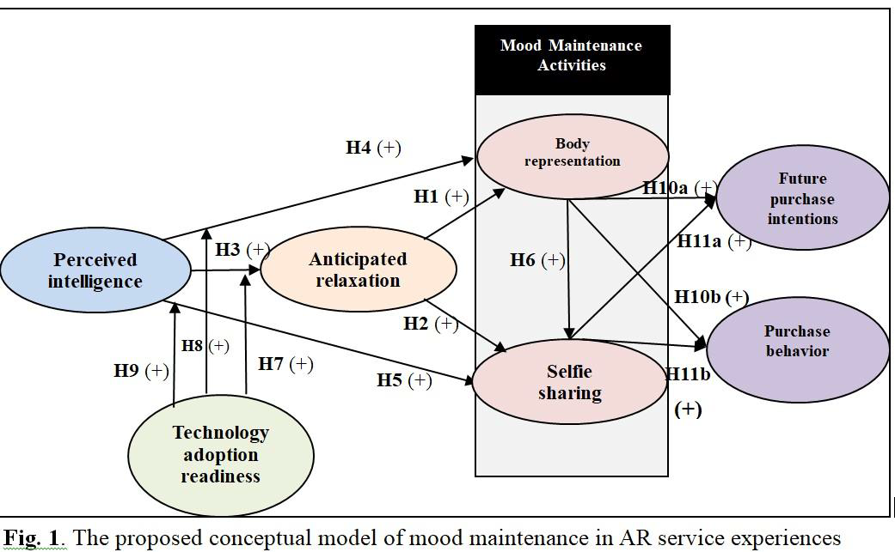
Proposed
Conceptual
Model
Tseng-LungHuang,
RodoulaH.Tsiotsou&
BenS.Liu

Slide 4
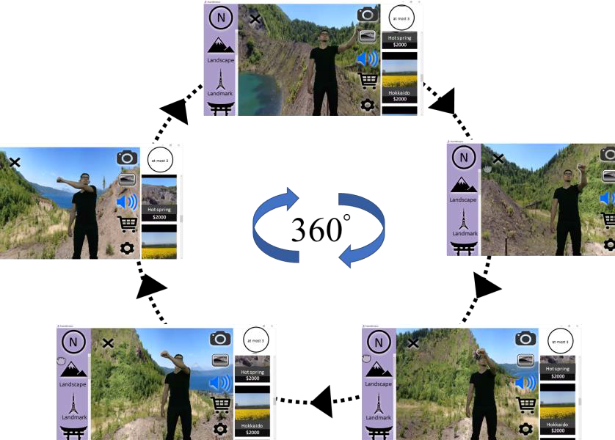
METHOD
First, we used a 360°AR panorama to generate
instant observing and tracking of AR consumers’
movement and action. Second, we created AR
intelligent thought and instant response effects to AR
consumers’ somatosensory manipulation. Finally, we
used virtual–physical integration technology to
shape the body representation of AR consumers.
Thus, AR consumers could freely share a selfie that
integrates their body images with a virtual tourism
destination. We chose travel destinations from
Japanese scenes in the AR environment from the
country's northern, central, and southern regions.

Slide 5
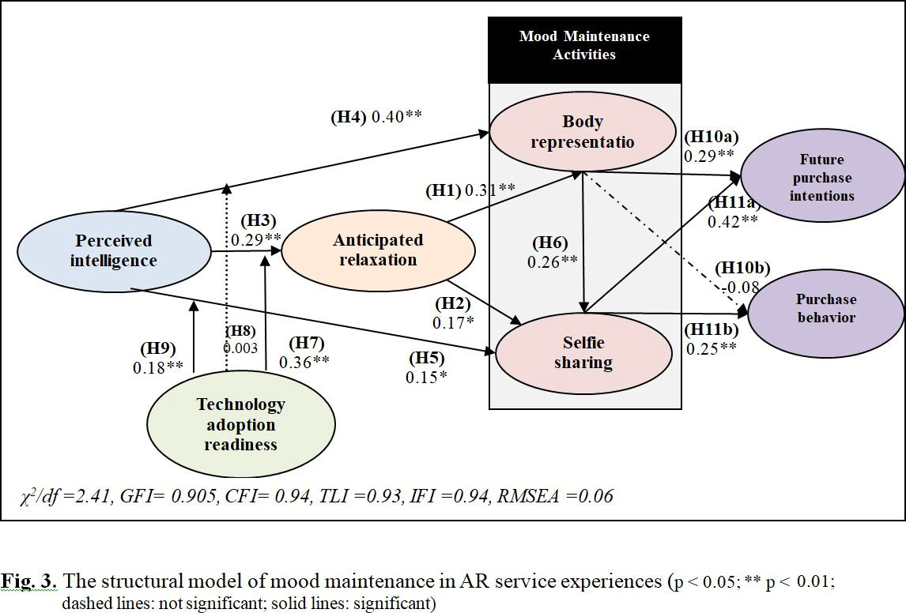
RESULTS
Tseng-LungHuang,RodoulaH.Tsiotsou&BenS.Liu

