Slide 1
DISPLAY ADVERTISING:
THE ROLE OF CONTEXT &
ADVERTISING APPEALS
FROM A RESISTANCE
PERSPECTIVE
Rodoula H. Tsiotsou, Leonidas Hatzithomas
& Martin Wetzels

Slide 2
THE PURPOSE
This study aims to investigate the role of
display advertising elements and consumers'
resistance to the successful launch of a brand
into a new market. Specifically, the
1
objectives of this research are:
(1) to understand the role of consumers’
resistance when launching a brand into a
2
new market via display advertising,
(2) to explore the effects of the digital
context of display advertising (congruent
context vs. non-congruent context),
3
(3) display advertising appeal (emotional vs.
informative), and (4) type of exposure
(forced vs. incidental) on display advertising
effectiveness.

Slide 3
STUDY 1
Eighty (80) undergraduate students
were guided to a website (one of the
two versions) and asked to surf for
three minutes. There were two ads on
the website, one with the targeted
brand (energy drink) and one for
another product (a laptop or a mobile
phone).

Slide 4
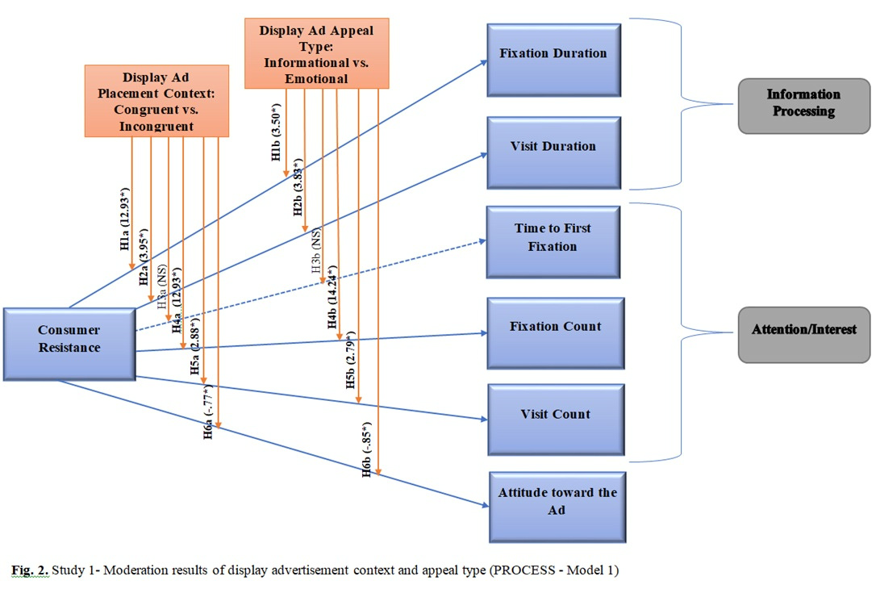
RESULTS

Slide 5
STUDY 2
138 undergraduate students were
guided to one of the two websites
and asked to surf for 3 minutes
and deliberately pay attention to
the targeted ad for 1 minute. On
the website, there were two ads,
one for the targeted brand (energy
drink) and one for another product
(a laptop or a mobile phone).
Finally, participants responded to
an online questionnaire.

Slide 6
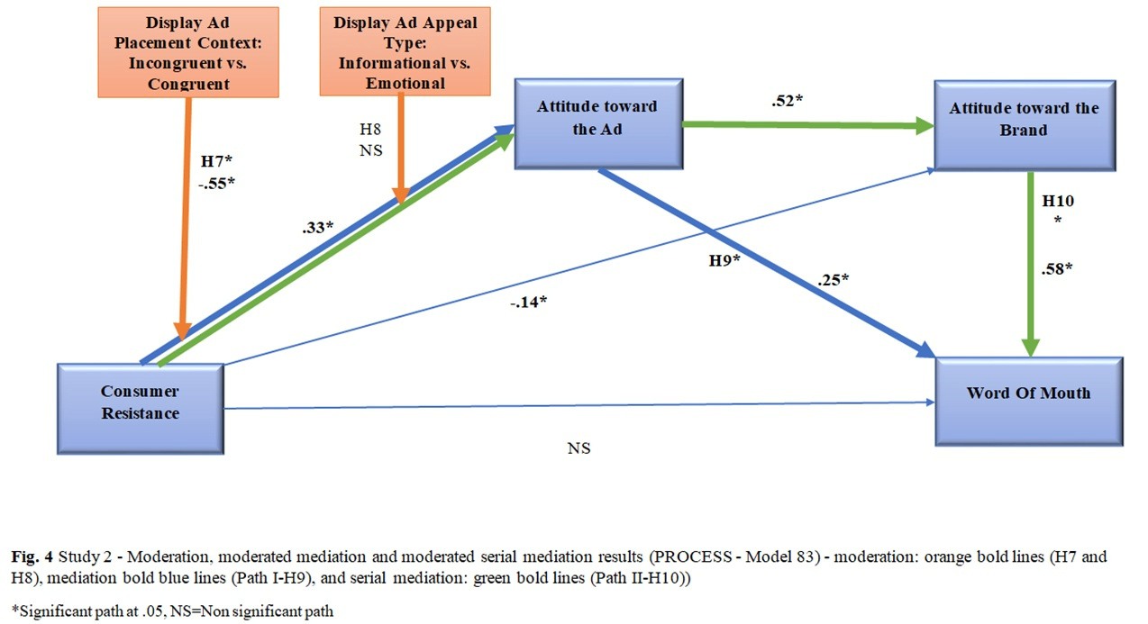
RESULTS

