Slide 1
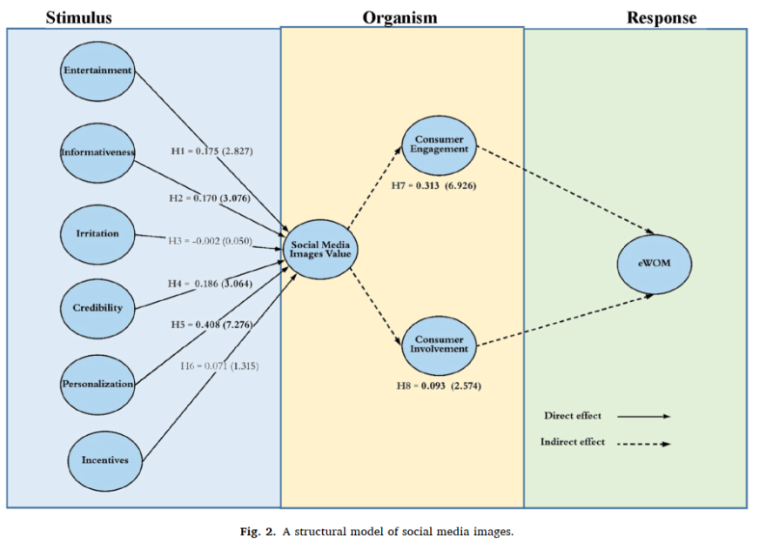
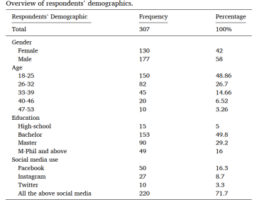
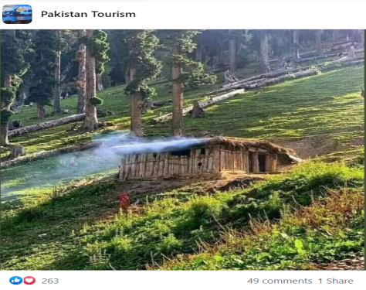
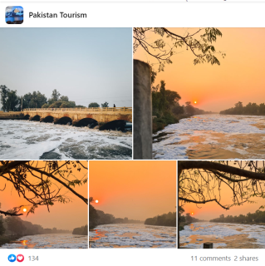
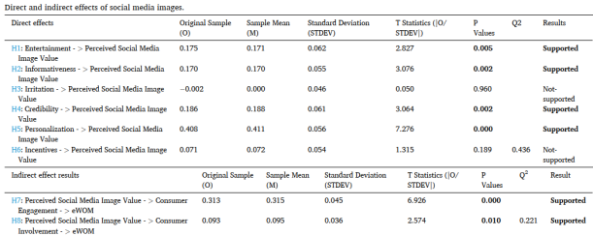
Investigating the impact of social media images’ value, consumer engagement,
and involvement on eWOM of a tourism destination: A transmittal mediation approach
By Abbasi, A.Z., Tsiotsou, R.H., Hussain, K., Rather, R.A., & Ding, H. T.
Results
This study aims to enrich our understanding of eWOM behavior in tourism by considering both social media content value (destination images) and consumer characteristics.
Study Objectives
A) to identify which social media destination image features (entertainment, informativeness, irritation, credibility, personalization, and incentives) contribute to building content value; (B) to examine the role of social media destination images value on eWOM; (C) to explore if customer engagement and involvement act as mediators in the relationship between social media destination images’ value and eWOM.
The survey research method was used to collect data from 330 tourists from Pakistan, online and offline.
Method
Journal of
Retailing & Consumer Services

