Slide 1
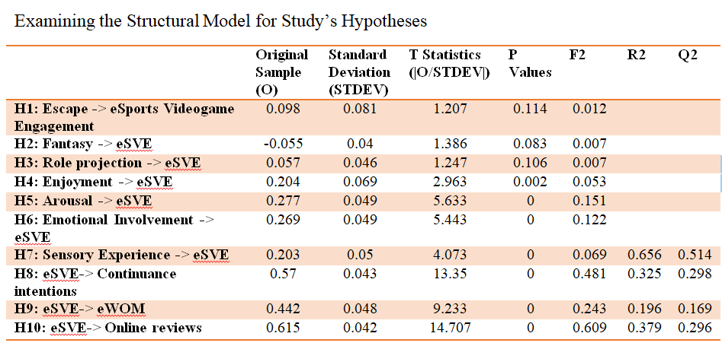
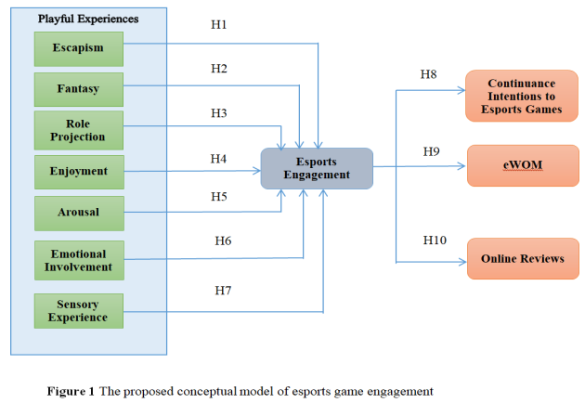
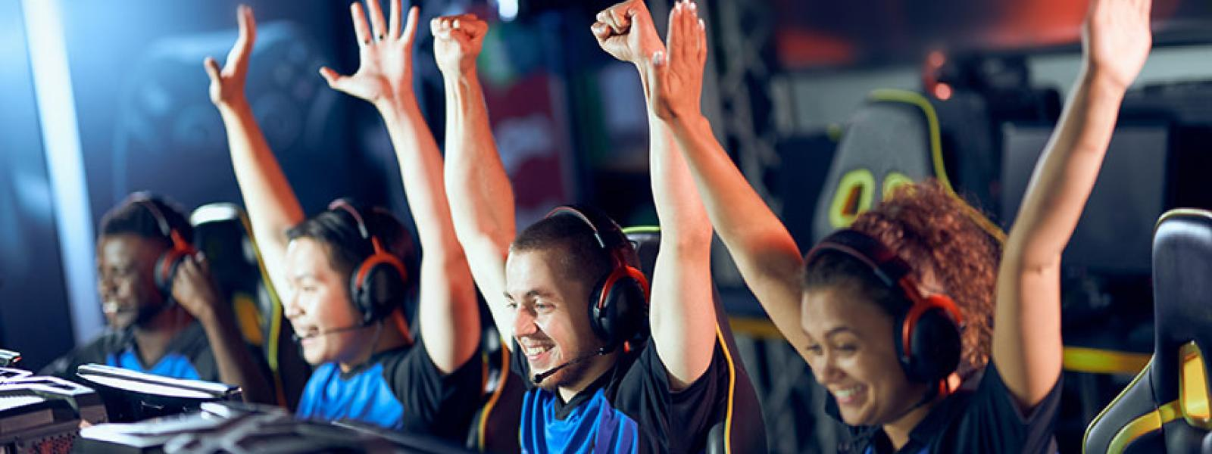
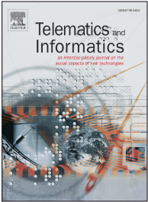
Esports as Playful Consumption Experiences:
Examining the Antecedents and Consequences of Videogame Engagement
Amir Zaib Abbasi, Nasser Alqahtani, Rodoula H. Tsiotsou, Umair Rehman, and Ding Hooi Ting
Results
This study aims to propose and test a conceptual model identifying playful-consumption experiences as potential drivers of consumer esports videogame engagement as well as continuance intentions, electronic word-of-mouth (eWOM), and online reviews as possible outcomes.
Proposed Conceptual Model
Method
Using the esports games' context, the survey research method was used to collect data data from 290 gamers. The study utilized PLS-SEM using SmartPLS 3.3.9 to test the structural model.
Telematics & Informatics

